Slide 1
LINUX COMMAND &
BASH SHELL
SCRIPTING
COURSE - A

Slide 2

1
The Linux Command Line
2
Starting with Linux Shells
3
Shell Detail
4
Basic & Advance Bash Shell Commands

Slide 3
1
Linux Environment Variable
2
Linux File Permissions
3
Managing File System
4
Working with Editors

Slide 4
1
Shell Scripting Basics
2
Basic Script Building
3
Using Structured Commands
4
More Structured Commands

Slide 5
5
Handling User Input
6
Presenting Data
7
Script Control
8
Script Control Cont.

Slide 6
LET’S
START
WELCOME

Slide 7
Welcome!!
Insert the title of your subtitle Here

Slide 8
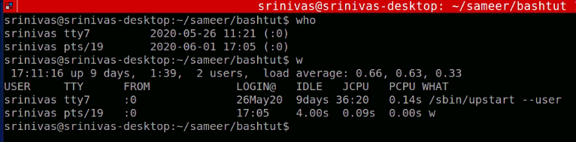
Using Multiple Commands
The key to shell scripts is the ability to enter multiple
commands and process the results from each command, even
possibly passing the results of one
command to another.

Slide 9
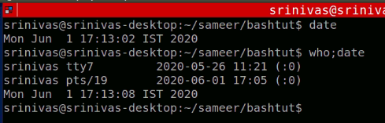
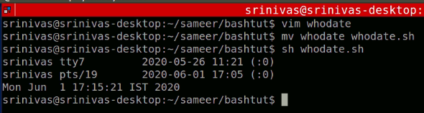
$ who;date
Instead of having to manually enter the commands onto a command line, you can combine the
commands into a simple sh file. When you need to run the commands, just simply run the script
file.

Slide 10
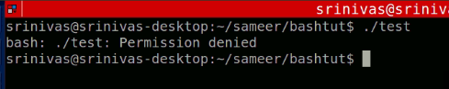
#!/bin/bash
The first line of a shell script file is a special case, and the pound sign followed by the exclamation point tells the shell what shell to run the script under.
vim test –
#!/bin/bash
who
date

Slide 11
#!/bin/sh — Execute the file using sh, the Bourne shell, or a compatible shell
#!/bin/csh — Execute the file using csh, the C shell, or a compatible shell
#!/usr/bin/perl -T — Execute using Perl with the option for taint checks
#!/usr/bin/php — Execute the file using the PHP command line interpreter
#!/usr/bin/python -O — Execute using Python with optimizations to code
#!/usr/bin/ruby — Execute using Ruby
In Linux system, we have shell which interprets our UNIX commands. Now there are a number of shell in Unix system. Among them, there is a shell called bash which is very very common Linux and it has a long history.
This is a by default shell in Linux.
When you write a script (collection of unix commands and so on) you have a option to specify which shell it can be
used. Generally you can specify which shell it wold be by using Shebang.
This operator allows the script to run by a specific shell on every occasion. So u may be using korn shell but if u run
the script it’s still going to use the Bourne shell.

Slide 12
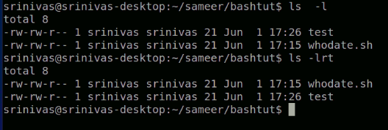
ls command, basically lists the contents of a directory.
ls -l : this command makes a long list of the contents of the directory, along with the file permissions, user,modification time, etc.
ls -lrt command lists the contents of the directory with all the details, in reverse order of their modification time (older files will be displayed first).

Slide 13
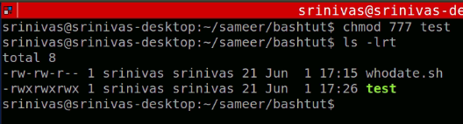
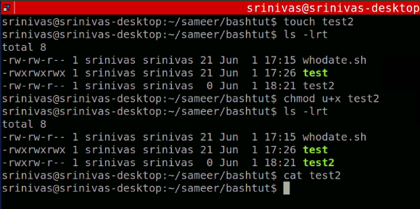

Slide 16
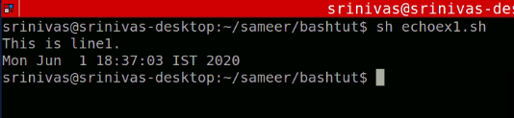
# ECHO
Echo is use to print the line to display in output screen.
echo “Hello Shell Scripting.”
vim echoexample.sh.
#!/bin/bash
echo “This is first line.”
date

Slide 17
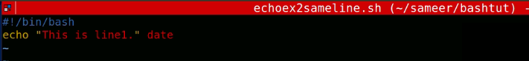
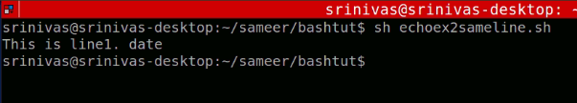
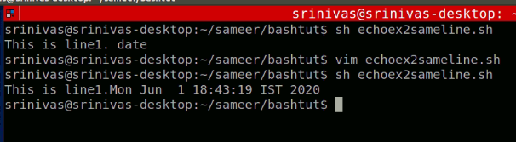
# what if I want my date also to be printing on same line of echo .
echo –n “This is line1.” date

Slide 18
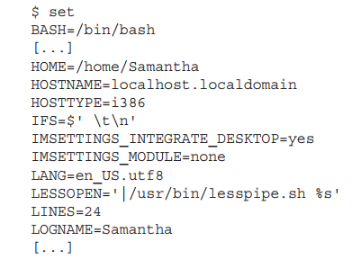
Variables allow you to temporarily store information within the shell script for use with other commands in the script.
The set command is a built-in function of the Bourne shell (sh), C shell (csh), and Korn
shell (ksh), which is used to define and determine the values of the system environment.
It can display a complete list of active environment variables available by using the set command:

Slide 19
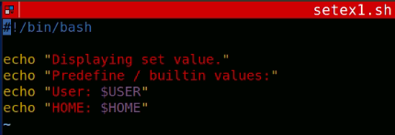
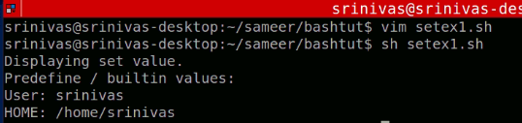
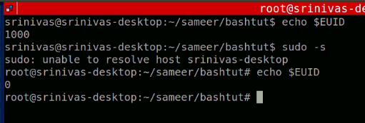

Slide 20
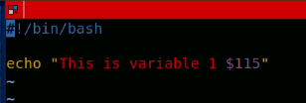
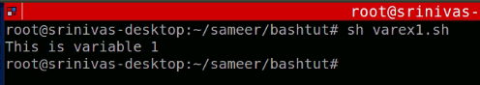
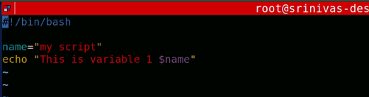

Slide 21
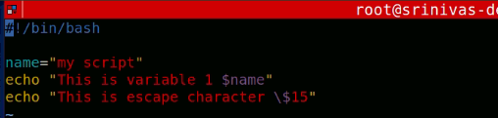
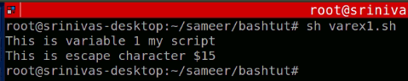
User variables can be any text string of up to 20 letters, digits, or an underscore character. Bash Scripting in CASE SENSATIVE, so var1 and VAR1 is two different variable in Bash Scripting.
No spaces can appear between the variable, the equal sign, and the value var1=10 var2=-57 var3=testing;var4="still more testing"

Slide 22
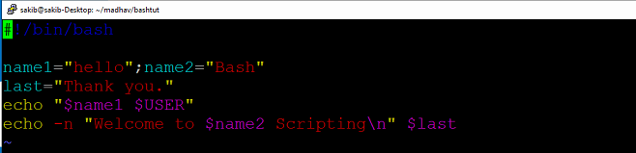


Slide 23
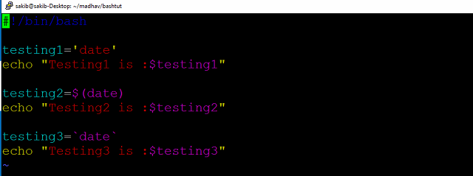
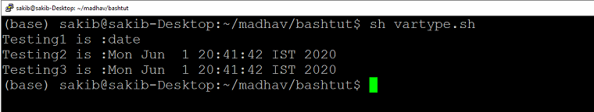
There are two ways to assign the output of a command to a variable: ■ The backtick character (`) ■ The $() format

Slide 24
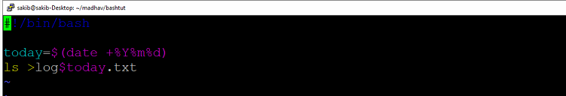
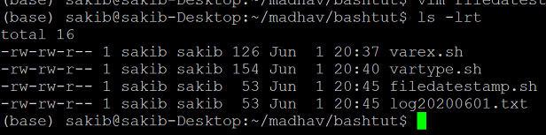
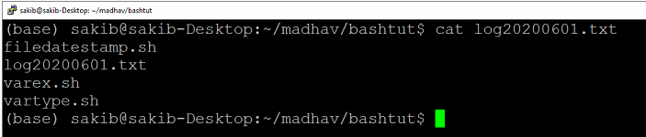

Slide 25
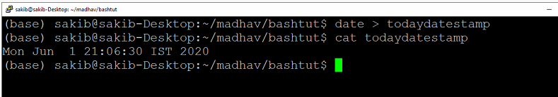
Redirecting Input and Output
Output redirection The most basic type of redirection is sending output from a command to a file. The bash shell uses the greater-than symbol (>) for this: command > outputfile

Slide 26
Sometimes, instead of overwriting the file’s contents, you may need to append output from a command to an existing file .
Append operation will happen.
In this situation, you can use the double greater-than symbol (>>) to append data: $ date >> test6 $ cat test6 user pts/0 Feb 10 17:55 Thu Feb 10 18:02:14 EDT 2014 $ The test6 file will contain the previous data as well as current date stamp data into it.

Slide 27
Input redirection Input redirection is the opposite of output redirection. Instead of taking the output of a command and redirecting it to a file, input redirection takes the content of a file and redirects it to a command.
command < inputfile
The wc command provides a count of text in the data. By default, it produces three values: ■ The number of lines in the text ■ The number of words in the text ■ The number of bytes in the text

Slide 28
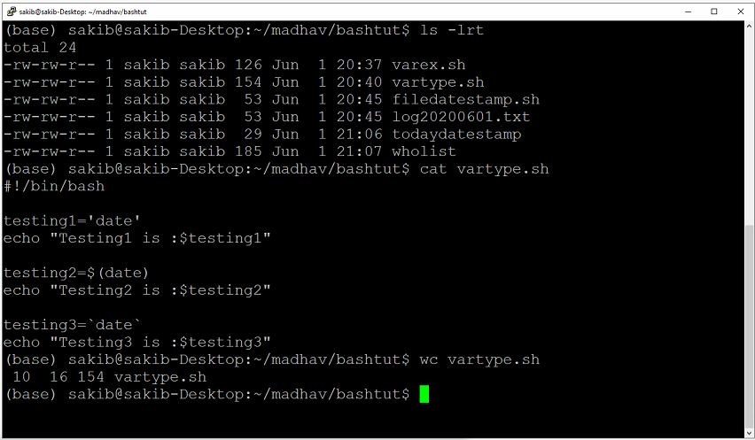

Slide 29
Another method of input redirection is called inline input redirection. This method allows you to specify the data for input redirection on the command line instead of in a file.
The inline input redirection symbol is the double less-than symbol (<<). Besides this symbol, you must specify a text marker that delineates the beginning and end of the data usedfor input. You can use any string value for the text marker, but it must
be the same at the beginning of the data and the end of the data:
command << marker data marker
$ wc << EOF > test string 1 > test string 2 > test string 3 > EOF
3 9 42

Slide 30
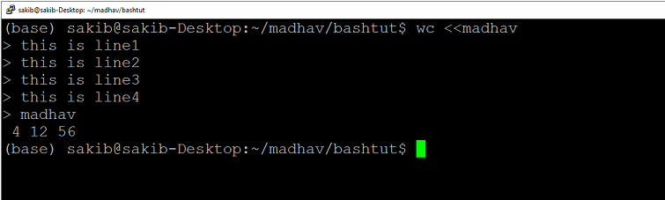
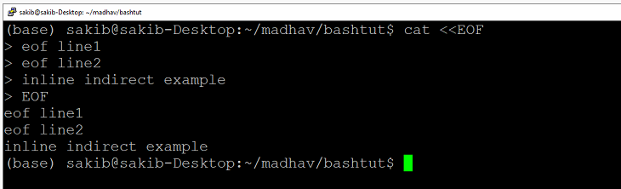

Slide 31
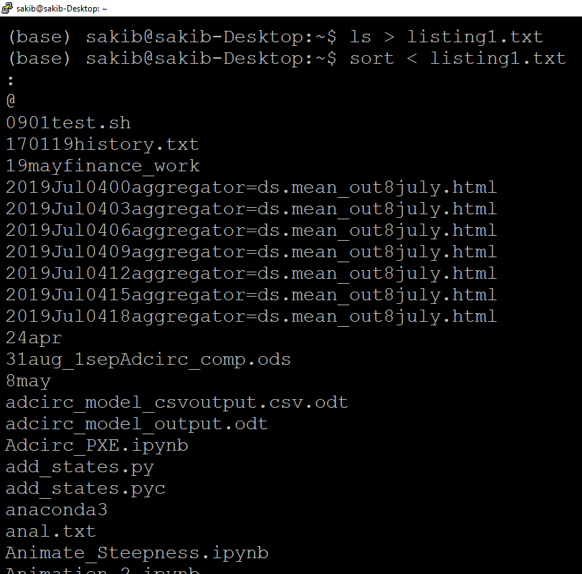
PIPES
Sometimes, you need to send the output of one command to the input of another command. This is possible using redirection, but Pipe is best option to do this.

Slide 32
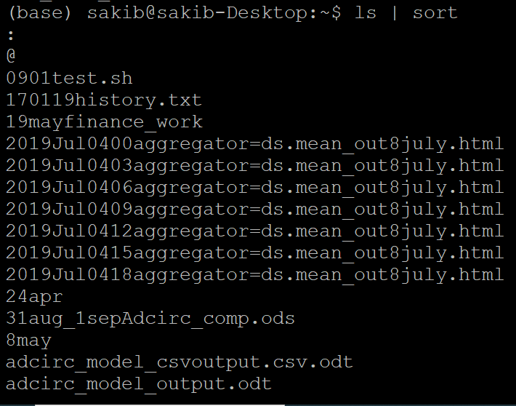
Instead of redirecting the output of a command to a fi le, you can redirect the output to another command. This process is called piping.
The pipe symbol often looks like a single vertical line in print (|). On a U.S. keyboard, it is usually on the same key as the backslash (\). The pipe is put between the commands to redirect the output from one to the other: command1 | command2
Don’t think of piping as running two commands back to back. The Linux system actually runs both commands at the same time, linking them together internally in the system. As the first command produces output, it’s sent immediately to the second command. No intermediate files or buffer
areas are used to transfer the data.

Slide 33
The piping feature operates in real time.
There’s no limit to the number of pipes you can use in a command. You can continue piping the output of commands to other commands to refine your operation.
To get even fancier, you can use redirection along with piping to save your output to a file:
#The rpm command manages the software packages installed on systems using the Red Hat Package Management system (RPM). $ rpm -qa | sort > rpm.list $ more rpm.list
By far one of the most popular uses of piping is piping the results of commands that produce long output to the more
command. When we have long list of output, then to see part of output we use more, so this pipe option will work fine here
As we will put Pipe and then more to the output.

Slide 34
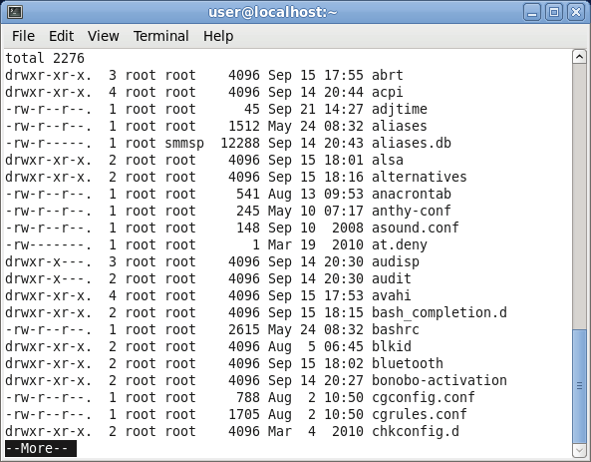
Here Total list of files are 2276 , just to see first part of output we are using more.

Slide 35
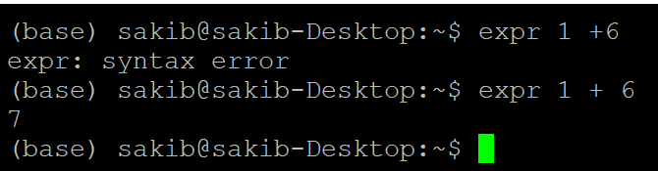
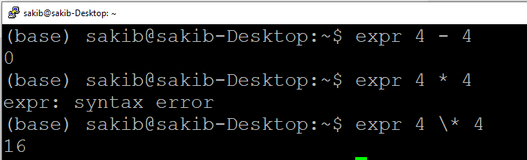
PERFORMING MATH There are two different ways to perform mathematical operations in your shell scripts.
1- The expr command 2- Using brackets 1- The expr command
The Bourne shell provided a special command that was used for processing mathematical equations. The expr command allowed the processing of equations from the command line, but it is extremely clunky:

Slide 36
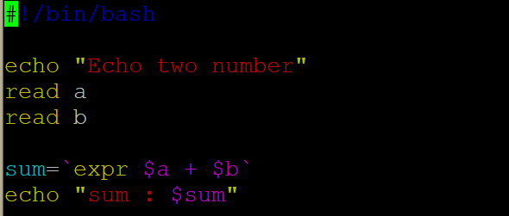
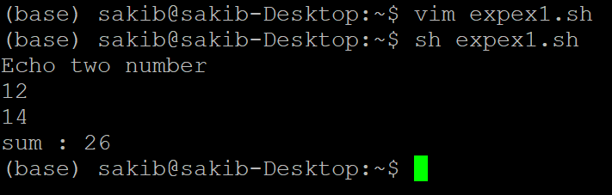

Slide 37
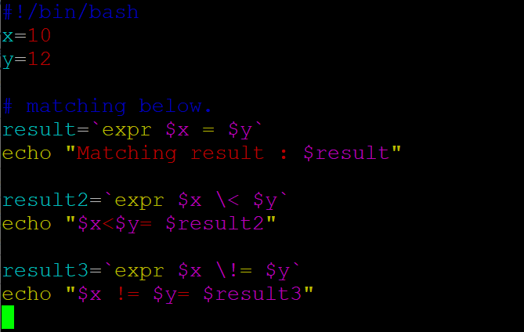
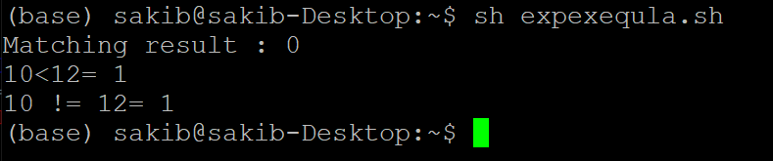

Slide 38
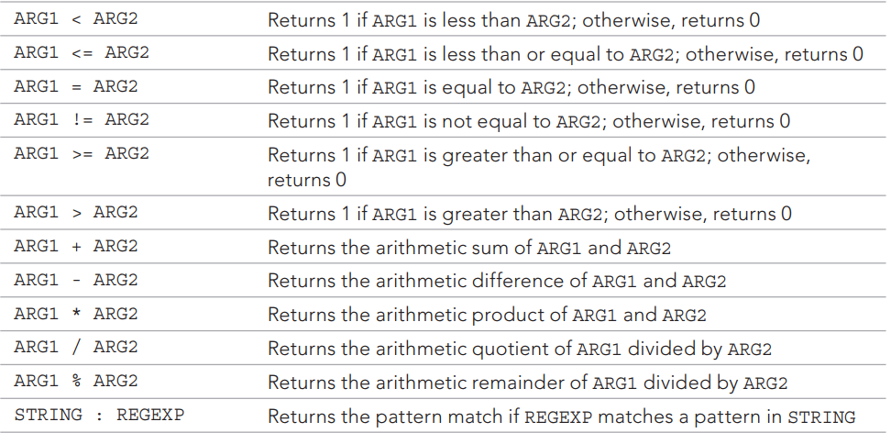

Slide 39
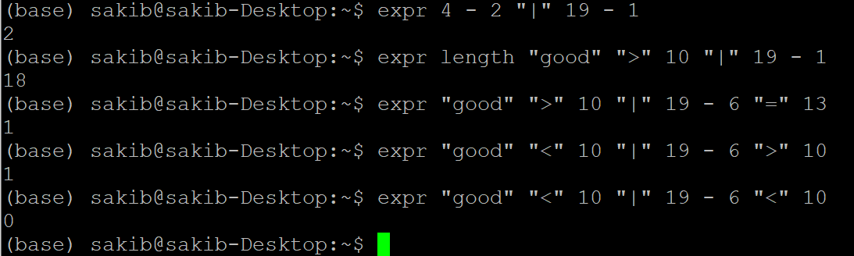
ARG1 | ARG2 Returns ARG1 if neither argument is null or zero; otherwise, returns ARG2

Slide 40
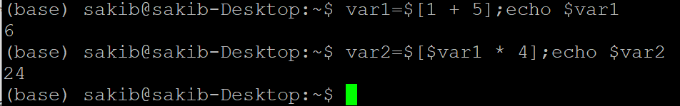
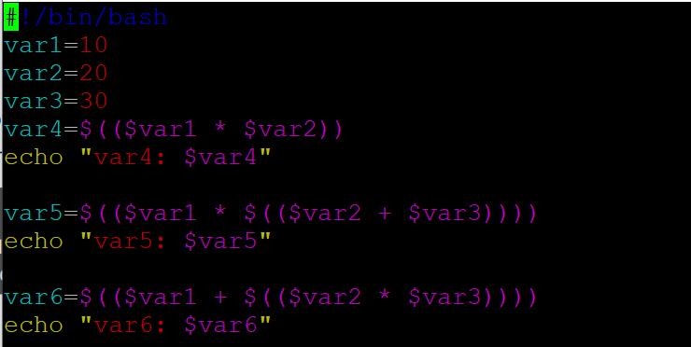
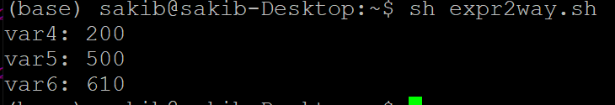
2- Using Bracket.
Can enclose the mathematical equation using a dollar sign and square brackets ($[ operation ]):

Slide 41
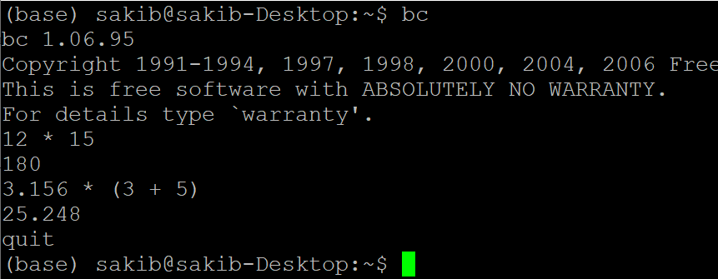
A floating-point solution The built-in bash calculator, called bc. The bash calculator is actually a programming language that allows you to enter floatingpoint expressions at a command line and then interprets the expressions, calculates them, and returns the result. The bash calculator recognizes these: ■ Numbers (both integer and floating point) ■ Variables (both simple variables and arrays) ■ Comments (lines starting with a pound sign or the C language /* */ pair) ■ Expressions ■ Programming statements (such as if-then statements) ■ Functions

Slide 42
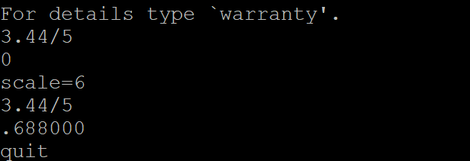
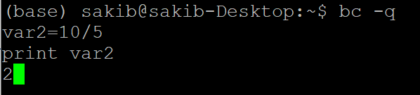
The floating-point arithmetic is controlled by a built-in variable called scale. You must set this value to the desired number of decimal places you want in your answers, or you won’t get what you were looking for:
The -q command line parameter suppresses the lengthy welcome banner from the bash calculator.
After a variable value is defined, you can use the variable throughout the bash calculator session. The print statement allows you to print variables and numbers.

Slide 43
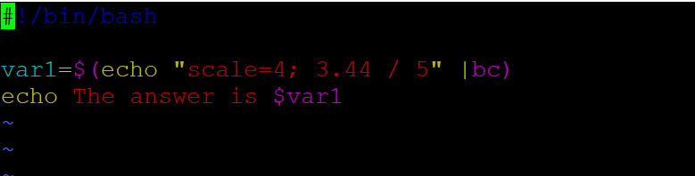


Slide 44
The bc command recognizes input redirection, allowing you to redirect a fi le to the bc command for processing. However, this also can get confusing, because you’d need to
store your expressions in a file. The best method is to use inline input redirection, which allows you to redirect data directly from the command line. In the shell script, you assign the output to a variable: variable=$(bc << EOF options statements expressions EOF )

Slide 45
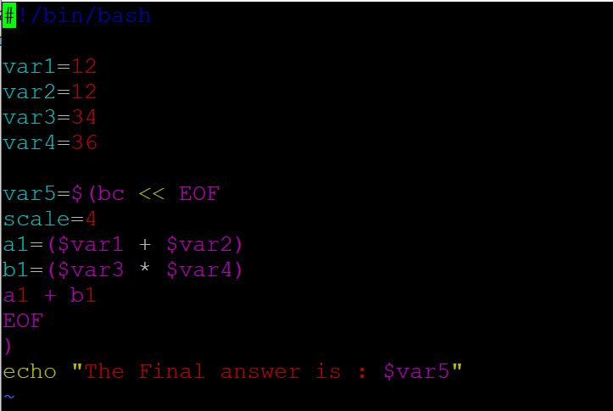
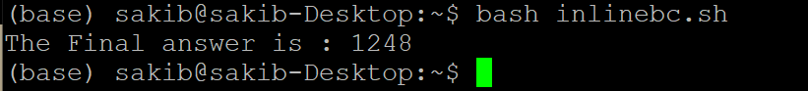

Slide 46

Exiting the Script
Every command that runs in the shell uses an exit status to indicate to the shell that it’s finished processing. The exit status is an integer value between 0 and 255 that’s passed by the command to the shell when the command finishes running. You can capture this value and use it in your scripts.
Checking the exit status Linux provides the $? special variable that holds the exit status value from the last command that executed. You must view or use the $? variable immediately after the command you want to check. It changes values to the exit status of the last command executed by the shell:

Slide 47


Slide 48


User define exit number
You can change that to return your own exit status code. The exit command allows you to specify an exit status when your script ends:

Slide 49



Slide 51
Using Structured Commands
Working with the if-then statement
Nesting ifs
Understanding the test command
Testing compound conditions
Using double brackets and parentheses
Looking at case

Slide 52
As we know that Bash is Interpreter language.
Many programs require some sort of logic flow control between the commands in the script. There is a whole command class that allows the script to skip over executed commands
based on tested conditions. These commands are generally referred to as structured
commands.
The structured commands allow you to alter the operation flow of a program. Quite a few
Structured commands are available in the bash shell, so we’ll look at them individually.
Working with the if-then Statement The most basic type of structured command is the if-then statement. The if-then statement has the following format:
if command then commands fi

Slide 53


The bash shell if statement runs the command defined on the if line. If the exit status of the command is zero (the command completed successfully), the commands listed under the then section are executed. If the exit status of the command is anything else, the then commands aren’t executed, and the bash shell moves on to the next command in the script. The
fi statement delineates/indicates the if-then statement’s end.

Slide 54


Slide 55



Slide 56


integers can only be compared with:
-eq # equal -ne # not equal -lt # less than -le # less than or equal -gt # greater than -ge # greater than or equal
Integers can only be compared with:
-eq # equal
-ne # not equal
-lt # less than
-le # less than or equal ; -gt # greater than ; -ge # greater than or equal.

Slide 57
In the if-then statement, you have only one option for whether a command is successful. If the command returns a non-zero exit status code, the bash shell just moves on to the next command in the script. In this situation, it would be nice to be able to execute an alternate set of commands. That’s exactly what the if-then-else statement is for. The if-then-else statement provides another group of commands in the statement:
if command then commands else commands fi
When the command in the if statement line returns with a zero exit status code, the commands listed in the then section are executed, just as in a normal if-then statement. When the command in the if statement line returns a non-zero exit status code, the bash shell executes the commands in the else section.

Slide 58


Slide 59


# Two if .

Slide 60




Slide 61
Instead of having to write separate if-then statements, you can use an alternative version of the else section, called elif. The elif continues an else section with another if-then statement: if command1 then commands elif command2 then more commands fi The elif statement line provides another command to evaluate, similar to the original if statement line. If the exit status code from the elif command is zero, bash executes the commands in the second then statement section. Using this method of nesting provides cleaner code with an easier-to-follow logic flow:

Slide 62



Slide 63
You can continue to string elif statements together, creating one huge if-then-elif conglomeration: if command1 then command set 1 elif command2 then command set 2 elif command3 then command set 3 elif command4 then command set 4 fi
Each block of commands is executed depending on which command returns the zero exit status code. Remember that the bash shell executes the if statements in order, and only the first one that returns a zero exit status results in the then section being executed.

Slide 64
The test command provides a way to test different conditions in an if-then statement. If the condition listed in the test command evaluates to TRUE, the test command exits with a zero exit status code. This makes the if-then statement behave in much the same way that if-then statements work in other programming languages. If the condition is FALSE, the test command exits with a non-zero exit status code, which causes the ifthen statement to
exit. The format of the test command is pretty simple: test condition The condition is a series of parameters and values that the test command evaluates. When used in an if-then statement, the test command looks like this: if test condition then commands fi
If you leave out the condition portion of the test command statement, it exits with a non-zero exit status code and triggers any else block statements:

Slide 65



Slide 66

Using the test command, you can determine whether a variable has content. A simple condition expression is needed to determine whether a variable has content:

Slide 67
The bash shell provides an alternative way of testing a condition without declaring the test command in an if-then statement: if [ condition ] then commands fi The square brackets define the test condition. Be careful; you must have a space after the first bracket and a space before the last bracket, or you’ll get an error message.
The test command and test conditions can evaluate three classes of conditions: ■ Numeric comparisons ■ String comparisons ■ File comparisons

Slide 68



Slide 69


Using String comparisons.
Test conditions also allow you to perform comparisons on string values.

Slide 70

Trying to determine if one string is less than or greater than another is where things start getting tricky. Two problems often plague shell programmers when trying to use the greater-than or less-than features of test conditions: ■ The greater-than and less-than symbols must be escaped, or the shell uses them as redirection symbols, with the string values as filenames. ■ The greater-than and less-than order is not the same as that used with the sort command. The first item can result in a huge problem that often goes undetected when programming your scripts. By just using the greater-than symbol itself in the script, no errors are generated, but the results are wrong. The script interpreted the greater-than symbol as an output redirection.
To fix this problem, you need to properly escape the greater-than symbol

Slide 71

The second issue is a little more subtle, and you may not even run across it unless you are working with uppercase and lowercase letters. The sort command handles uppercase letters opposite to the way the test conditions consider them: Capitalized letters are treated as less than lowercase letters in test comparisons. However, the sort command does the opposite. When you put the same strings in a file and use the sort command, the lowercase letters appear first. This is due to different ordering techniques. Test comparisons use standard ASCII ordering, using each character’s ASCII numeric value to determine the sort order. The sort command uses the sorting order defined for the system locale language settings.

Slide 72


Slide 73

Looking at string size The -n and -z comparisons are handy when trying to evaluate whether a variable contains data: if [ -n $val1 ] The preceding code determines whether the val1 variable is non-zero in length, which it is, so its then section is processed. if [ -z $var2 ] This preceding code determines whether the val2 variable is zero in length, which it is, so its then section is processed.

Slide 74


Slide 75


Using file comparisons

Slide 76


These conditions give you the ability to check filesystem files within shell scripts. They are often used in scripts that access files. Because they’re used so often.

Slide 77


Checking whether an object exists The -e comparison allows you to check if either a file or directory object exists before you attempt to use it in your script:

Slide 78


The -e comparison works for both files and directories. To be sure that the object specified is a file and not a directory, you must use the -f comparison:

Slide 79


Before trying to read data from a file, it’s usually a good idea to test whether you can read from the file first. You do this with the -r comparison:

Slide 80



Slide 81



Slide 82



Slide 83
Considering Compound Testing The if-then statement allows you to use Boolean logic to combine tests. You can use these two Boolean operators:
■ [ condition1 ] && [ condition2 ] ■ [ condition1 ] || [ condition2 ]
The first Boolean operation uses the AND Boolean operator to combine two conditions. Both conditions must be met for the then section to execute.
The second Boolean operation uses the OR Boolean operator to combine two conditions. If either condition evaluates to a TRUE condition, the then section is executed.

Slide 84



Slide 85
Working with Advanced if-then Features Two additions to the bash shell provide advanced features that you can use in if-then statements: ■ Double parentheses for mathematical expressions ■ Double square brackets for advanced string handling functions Using double parentheses The double parentheses command allows you to incorporate advanced mathematical formulas in your comparisons. The test command allows for only simple arithmetic operations in the comparison. The double parentheses command provides more mathematical symbols, which programmers who have used other programming languages may be familiar with using. Here’s the format of the double parentheses command:
(( expression ))
The expression term can be any mathematical assignment or comparison expression.
Besides the standard mathematical operators that the test command uses.

Slide 86



Slide 87


Notice that you don’t need to escape the greater-than symbol in the expression within the
double parentheses. This is yet another advanced feature besides the double parentheses
command.
As we used to use if [ $var1 \< $var2 ] here in double square bracket we need not to use escape character \ ( backwardslash )

Slide 88
Using double brackets The double bracket command provides advanced features for string comparisons. Here’s the double bracket command format:
[[ expression ]]
The double bracketed expression uses the standard string comparison used in the test evaluations. However, it provides an additional feature that the test evaluations don’t — pattern matching.
In pattern matching, you can defi ne a regular expression that’s matched against the string value:

Slide 89



Slide 90
Considering the case Command Often, you’ll find yourself trying to evaluate a variable’s value, looking for a specific value within a set of possible values. In this scenario, you end up having to write a lengthy if-then-else statement, like this: $ cat test25.sh #!/bin/bash # looking for a possible value # if [ $USER = "rich" ] then echo "Welcome $USER" echo "Please enjoy your visit" elif [ $USER = "barbara" ] then echo "Welcome $USER" echo "Please enjoy your visit" elif [ $USER = "testing" ] then echo "Special testing account" elif [ $USER = "jessica" ]

Slide 91
then echo "Do not forget to logout when you're done" else echo "Sorry, you are not allowed here" fi $ $ ./test25.sh Welcome rich Please enjoy your visit $ The elif statements continue the if-then checking, looking for a specific value for the single comparison variable. Instead of having to write all the elif statements to continue checking the same variable value, you can use the case command. The case command checks multiple values of a single variable in a list-oriented format:
case variable in pattern1 | pattern2) commands1;; pattern3) commands2;; *) default commands;; esac

Slide 92
The case command compares the variable specified against the different patterns. If the variable matches the pattern, the shell executes the commands specified for the pattern. You can list more than one pattern on a line, using the bar operator to separate each pattern. The asterisk symbol is the catch-all for values that don’t match any of the listed patterns. Here’s an example of converting the if-then-else program to using the case command: $ cat test26.sh #!/bin/bash # using the case command # case $USER in rich | barbara) echo "Welcome, $USER" echo "Please enjoy your visit";; testing) echo "Special testing account";; jessica) echo "Do not forget to log off when you're done";; *) echo "Sorry, you are not allowed here";; esac $

Slide 93



Slide 94



Slide 95
More Structured Commands The for Command: Iterating through a series of commands is a common programming practice. Often, you need to repeat a set of commands until a specific condition has been met, such as processing all the files in a directory, all the users on a system, or all the lines in a text file. The bash shell provides the for command to allow you to create a loop that iterates through a series of values. Each iteration performs a defined set of commands using one of the values in the series. Here’s the basic format of the bash shell for command:
for var in list do commands done
You supply the series of values used in the iterations in the list parameter.
You can specify the values in the list in several ways.

Slide 96


In each iteration, the variable var contains the current value in the list. The first iteration uses the first item in the list, the second iteration the second item, and so on until all the items in the list have been used. The commands entered between the do and done statements can be one or more standard bash shell commands. Within the commands, the $var variable contains the current list item value for the iteration.

Slide 97



Slide 98
The $test variable retained its value and allowed us to change the value and use it outside of the for command loop, as any other variable would.
# Complex Example:-
$ cat badtest1 #!/bin/bash # another example of how not to use the for command for test in I don't know if this'll work do echo "word:$test" done $ ./badtest1 word:I word:dont know if thisll word:work $
The shell saw the single quotation marks within the list values and attempted to use them to define a single data value.

Slide 99
You have two ways to solve this problem: ■ Use the escape character (the backslash) to escape the single quotation mark. ■ Use double quotation marks to define the values that use single quotation marks

Slide 100



Slide 101
If there are spaces in the individual data values, you must accommodate them using double quotation marks: $ cat test3 #!/bin/bash # an example of how to properly define values for test in Nevada "New Hampshire" "New Mexico" "New York" do echo "Now going to $test" done $ ./test3 Now going to Nevada Now going to New Hampshire Now going to New Mexico Now going to New York $

Slide 102


Reading a list from a variable
Often what happens in a shell script is that you accumulate a list of values stored in a variable and then need to iterate through the list. You can do this using the for command as well:

Slide 103




Slide 104
This example uses the cat command in the command substitution to display the contents of the file states. Notice that the states file includes each state on a separate line, not separated by spaces. The for command still iterates through the output of the cat command one line at a time, assuming that each state is on a separate line. However, this doesn’t solve the problem of having spaces in data. If you list a state with a space in it, the for command still takes each word as a separate value.
# Another way of same above output.
#!/bin/bash
filename=states.txt
for i in `cat $filename`;do
echo $i
done

Slide 105
CHANGING THE FIELD SEPARATOR The cause of this problem is the special environment variable IFS, called the internal field separator. The IFS environment variable defines a list of characters the bash shell uses as field separators. By default, the bash shell considers the following characters as field separators: ■ A space ■ A tab ■ A newline If the bash shell sees any of these characters in the data, it assumes that you’re starting a new data field in the list.
if you want to change the IFS value to recognize only the newline character, you need to do this:
IFS=$'\n’
Adding this statement to your script tells the bash shell to ignore spaces and tabs in data values.

Slide 106




Slide 107
Other excellent applications of the IFS environment variable are possible. Suppose you want to iterate through values in a file that are separated by a colon (such as in the /etc/ passwd file). You just need to set the IFS value to a colon: IFS=: If you want to specify more than one IFS character, just string them together on the assignment line:
IFS=$'\n’:;”
This assignment uses the newline, colon, semicolon, and double quotation mark characters as field separators. There’s no limit to how you can parse your data using the IFS
characters.

Slide 108




Slide 109
READING A DIRECTORY USING WILDCARDS Finally, you can use the for command to automatically iterate through a directory of files. To do this, you must use a wildcard character in the file or pathname. This forces the shell to use file globbing. File globbing is the process of producing filenames or pathnames that match a specified wildcard character.

Slide 110



Slide 111
The C language for command The C language for command has a specific method for specifying a variable, a condition that must remain true for the iterations to continue, and a method for altering the variable for each iteration. When the specified condition becomes false, the for loop stops. The condition equation is defined using standard mathematical symbols. For example, consider the following C language code:
for (i = 0; i < 10; i++) { printf("The next number is %d\n", i); }
This code produces a simple iteration loop, where the variable i is used as a counter. The first section assigns a default value to the variable. The middle section defines the condition under which the loop will iterate. When the defined condition becomes false, the for loop stops iterations. The last section defines the iteration process. After each iteration, the expression defined in the last section is executed. In this example, the i variable is incremented by one after each iteration.

Slide 112
The basic format of the C-style bash for loop:
for (( variable assignment ; condition ; iteration process ))
Here’s what a C-style for command looks like: for (( a = 1; a < 10; a++ ))
Notice that there are a couple of things that don’t follow the standard bash shell for method, not following bash rules: ■ The assignment of the variable value can contain spaces. ■ The variable in the condition isn’t preceded with a dollar sign. ■ The equation for the iteration process doesn’t use the expr command format.

Slide 113



Slide 114



Slide 115
The while Command
The while command is somewhat of a cross between the if-then statement and the for loop. The while command allows you to define a command to test and then loop through a set of commands for as long as the defined test command returns a zero exit status. It tests the test command at the start of each iteration. When the test command returns a nonzero exit status, the while command stops executing the set of commands. Basic while format Here’s the format of the while command:
while test command do other commands done

Slide 116


The test command defined in the while command is the exact same format as in if-then statements . As in the if-then statement, you can use any normal bash shell command, or you can use the test command to test for conditions, such as variable values. The key to the while command is that the exit status of the test command specified must change, based on the commands run during the loop. If the exit status never changes, the while loop will get stuck in an infinite loop.

Slide 117




Slide 118

Using multiple test commands The while command allows you to define multiple test commands on the while statement line. Only the exit status of the last test command is used to determine when the loop stops. This can cause some interesting results if you’re not careful.
while echo $var1 [ $var1 -ge 0 ] do
............
done
This demonstrates that in a multi-command while statement, all the test commands are executed in each iteration, including the last iteration when the last test command fails. Be careful of this. Another thing to be careful of is how you specify the multiple test commands. Note
that each test command is on a separate line! SECOND CONDITION ONLY MATTER.

Slide 119



Slide 120
The until Command The until command works in exactly the opposite way from the while command. The until command requires that you specify a test command that normally produces a nonzero exit status. As long as the exit status of the test command is non-zero, the bash shell executes the commands listed in the loop. When the test command returns a zero exit status, the loop stops. As you would expect, the format of the until command is:
until test commands do other commands done
Similar to the while command, you can have more than one test command in the until command statement. Only the exit status of the last command determines if the bash shell executes the other commands defined.

Slide 121



Slide 122


Nesting Loops A loop statement can use any other type of command within the loop, including other loop commands. This is called a nested loop.

Slide 123
Looping on File Data Often, you must iterate through items stored inside a file. This requires combining two of the techniques covered: ■ Using nested loops ■ Changing the IFS environment variable By changing the IFS environment variable, you can force the for command to handle each line in the file as a separate item for processing, even if the data contains spaces. After you’ve extracted an individual line in the file, you may have to loop again to extract data contained within it.

Slide 124
The following is an example of doing just that: #!/bin/bash # changing the IFS value IFS.OLD=$IFS IFS=$'\n' for entry in $(cat /etc/passwd) do echo "Values in $entry –" IFS=: for value in $entry
do echo " $value" done done $ This script uses two different IFS values to parse the data. The first IFS value parses the individual lines in the /etc/passwd file. The inner for loop next changes the IFS value to the colon, which allows you to parse the individual values within the /etc/passwd lines.

Slide 125
When you run this script, you get output something like this: Values in rich:x:501:501:Rich Blum:/home/rich:/bin/bash - rich x 501 501 Rich Blum /home/rich /bin/bash Values in katie:x:502:502:Katie Blum:/home/katie:/bin/bash - katie x 506 509 Katie Blum /home/katie /bin/bash The inner loop parses each individual value in the /etc/passwd entry. This is also a great way to process comma-separated data, a common way to import spreadsheet data.

Slide 126
Controlling the Loop You might be tempted to think that after you start a loop, you’re stuck until the loop finishes all its iterations. This is not true. A couple of commands help us control what happens inside of a loop: ■ The break command ■ The continue command Each command has a different use in how to control the operation of a loop.
THE BREAK COMMAND
The break command is a simple way to escape a loop in progress. You can use the break command to exit any type of loop, including while and until loops.
Breaking out of a single loop When the shell executes a break command, it attempts to break out of the loop that’s
currently processing:

Slide 127



Slide 128



Slide 129
BREAKING OUT OF AN INNER LOOP When you’re working with multiple loops, the break command automatically terminates the innermost loop you’re in: $ cat test19 #!/bin/bash # breaking out of an inner loop for (( a = 1; a < 4; a++ )) do echo "Outer loop: $a" for (( b = 1; b < 100; b++ )) do if [ $b -eq 5 ] then break fi echo " Inner loop: $b" done done

Slide 130
$ ./test19 Outer loop: 1 Inner loop: 1 Inner loop: 2 Inner loop: 3 Inner loop: 4 Outer loop: 2 Inner loop: 1 Inner loop: 2 Inner loop: 3 Inner loop: 4 Outer loop: 3 Inner loop: 1 Inner loop: 2 Inner loop: 3 Inner loop: 4 $

Slide 131
The for statement in the inner loop specifies to iterate until the b variable is equal to 100. However, the if-then statement in the inner loop specifies that when the b variable
value is equal to 5, the break command is executed. Notice that even though the inner
loop is terminated with the break command, the outer loop continues working as
specified.
BREAKING OUT OF AN OUTER LOOP
There may be times when you’re in an inner loop but need to stop the outer loop. The break command includes a single command line parameter value: break n where n indicates the level of the loop to break out of. By default, n is 1, indicating to break out of the current loop. If you set n to a value of 2, the break command stops the next level of the outer loop:

Slide 132



Slide 133

# when activating break 2 , i.e outer loop break .

Slide 134
THE CONTINUE COMMAND The continue command is a way to prematurely stop processing commands inside of a loop but not terminate the loop completely. This allows you to set conditions within a loop where the shell won’t execute commands.
You can use the continue command in for , while and until loops, but be extremely careful with what you’re doing. Remember that when the shell executes the continue command, it skips the remaining commands.

Slide 135



Slide 136


As with the break command, the continue command allows you to specify what level of loop to continue with a command line parameter:
continue n
where n defines the loop level to continue.

Slide 137



Slide 138
HANDLING USER INPUT
Sometimes, you need to write a script that has to interact with the person running the
script. The bash shell provides a few different methods for retrieving data from people .
PASSING PARAMETERS The most basic method of passing data to your shell script is to use command line parameter.Command line parameters allow you to add data values to the command line when you
Execute the script: $ ./addem 10 30
This example passes two command line parameters (10 and 30) to the script addem. The
Script handles the command line parameters using special variables. The following sections describe how to use command line parameters in your bash shell scripts.

Slide 139


READING PARAMETERS The bash shell assigns special variables, called positional parameters, to all of the command line parameters entered. This includes the name of the script the shell is executing. The positional parameter variables are standard numbers, with $0 being the script’s name, $1 being the first parameter, $2 being the second parameter, and so on, up to $9 for the ninth parameter.

Slide 140



Slide 141
Remember that each of the parameters is separated by a space, so the shell interpreted the space as just separating the two values. To include a space as a parameter value, you must use quotation marks (either single or double quotation marks):
$ ./test3.sh 'Rich Blum' Hello Rich Blum, glad to meet you. $ $ ./test3.sh "Rich Blum" Hello Rich Blum, glad to meet you. $ If your script needs more than nine command line parameters, you can continue, but the variable names change slightly. After the ninth variable, you must use braces around the variable number, such as ${10}. Here’s an example of doing that:

Slide 142



Slide 143
Reading the script name You can use the $0 parameter to determine the script name the shell started from the command line. This can come in handy if you’re writing a utility that can have multiple functions. $ cat test5.sh #!/bin/bash # Testing the $0 parameter # echo The zero parameter is set to: $0 #$ $ bash test5.sh The zero parameter is set to: test5.sh $

Slide 144


Slide 145
TESTING PARAMETERS Be careful when using command line parameters in your shell scripts. If the script is run without the parameters, bad things can happen: When the script assumes there is data in a parameter variable, and no data is present, most likely you’ll get an error message from your script. This is a poor way to write scripts. Always check your parameters to make sure the data is there before using it: check
parameter present or not by if else condition.
In below example, the -n test evaluation was used to check for data in the $1 command line parameter.

Slide 146



Slide 147
COUNTING PARAMETERS The special $# variable contains the number of command line parameters included when the script was run. You can use this special variable anywhere in the script, just like a
normal variable:

Slide 148



Slide 149
$ cat test10.sh #!/bin/bash # Grabbing the last parameter # params=$# echo echo The last parameter is $params echo The last parameter is ${!#} echo #$ $ bash test10.sh 1 2 3 4 5 The last parameter is 5 The last parameter is 5 $ $ bash test10.sh The last parameter is 0 The last parameter is test10.sh $

Slide 150
Perfect. This script also assigned the $# variable value to the variable params and then used that variable within the special command line parameter variable format as well. Both versions worked. It’s also important to notice that, when there weren’t any parameters on the command line, the $# value was zero, which is what appears in the params variable, but the ${!#} variable returns the script name used on the command line.

Slide 151
GRABBING ALL THE DATA The $* and $@ variables provide easy access to all your parameters. Both of these variables include all the command line parameters within a single variable. The $* variable takes all the parameters supplied on the command line as a single word. The word contains each of the values as they appear on the command line. Basically, instead of treating the parameters as multiple objects, the $* variable treats them all as one parameter. The $@ variable, on the other hand, takes all the parameters supplied on the command line as separate words in the same string. It allows you to iterate through the values, separating out each parameter supplied. This is most often accomplished using the for command.

Slide 152



Slide 153



Slide 154
Standardizing Options
Few letter options have achieved a somewhat standard meaning in the Linux world. If you leverage these options in your shell script, your scripts will be more user-friendly.

Slide 155


Slide 156


READING BASICS The read command accepts input either from standard input (such as from the keyboard) or from another file descriptor. After receiving the input, the read command places the data into a variable.

Slide 157
The echo command that produced the prompt uses the -n option. This suppresses the newline character at the end of the string, allowing the script user to enter data immediately after the string, instead of on the next line. This gives your scripts a more form-like appearance.
The read command includes the -p option, which allows you to specify a prompt directly in the read command line:

Slide 158



Slide 159


TIMING OUT Be careful when using the read command. Your script may get stuck waiting for the script user to enter data. If the script must go on regardless of whether any data was entered, you can use the -t option to specify a timer. The -t option specifies the number of seconds for the read command to wait for input. When the timer expires, the read command returns a non-zero exit status:

Slide 160


Because the read command exits with a non-zero exit status if the timer expires, it’s easy to use the standard structured statements, such as an if-then statement or a while loop to track what happened. In this example, when the timer expires, the if statement fails, and the shell executes the commands in the else section.

Slide 161

READING WITH NO DISPLAY Sometimes you need input from the script user, but you don’t want that input to display on the monitor. The classic example is when entering passwords, but there are plenty of other types of data that you need to hide. The -s option prevents the data entered in the read command from being displayed on the monitor; actually, the data is displayed, but the read command sets the text color to the same as the background color.

Slide 162


READING FROM A FILE Finally, you can also use the read command to read data stored in a file on the Linux system. Each call to the read command reads a single line of text from the file. When no more lines are left in the file, the read command exits with a non-zero exit status. The tricky part is getting the data from the file to the read command. The most common method is to pipe the result of the cat command of the file directly to a while command that contains the read command.

Slide 163
PRESENTING DATA
So far the scripts shown in this book display information either by echoing data to the monitor or by redirecting data to a file.
Now we will learn how to redirect the output of your script to different locations on your
Linux system.
So far, you’ve seen two methods for displaying the output from your scripts: ■ Displaying output on the monitor screen ■ Redirecting output to a file Both methods produced an all-or-nothing approach to data output. There are times,
however, when it would be nice to display some data on the monitor and other data in a file. For these instances, it comes in handy to know how Linux handles input and output so you can get your script output to the right place.

Slide 164

The following sections describe how to use the standard Linux input and output system to your advantage, to help direct script output to specific locations.
STANDARD FILE DESCRIPTORS The Linux system handles every object as a file. This includes the input and output process.
Linux identifies each file object using a file descriptor. The file descriptor is a non-negative
integer that uniquely identifies open files in a session. Each process is allowed to have up to nine open file descriptors at a time. The bash shell reserves the first three file descriptors (0, 1, and 2) for special purposes.

Slide 165
These three special file descriptors handle the input and output from your script. The shell uses them to direct the default input and output in the shell to the appropriate location, which by default is usually your monitor. Many bash commands accept input from STDIN, especially if no files are specified on the command line. Here’s an example of using the cat command with data entered from STDIN: $ cat this is a test this is a test this is a second test. this is a second test. When you enter the cat command on the command line by itself, it accepts input from STDIN. As you enter each line, the cat command echoes the line to the display. However, you can also use the STDIN redirect symbol < to force the cat command to accept input from another file other than STDIN:

Slide 166
$ cat < testfile This is the first line. This is the second line.
This is the third line. $ Now the cat command uses the lines that are contained in the testfile file as the input. You can use this technique to input data to any shell command that accepts data from STDIN. (STDIN taking from screen or writing into file.)
STDOUT The STDOUT file descriptor references the standard output for the shell. On a terminal interface, the standard output is the terminal monitor. All output from the shell (including programs and scripts you run in the shell) is directed to the standard output, which is the monitor. Most bash commands direct their output to the STDOUT file descriptor by default.
(STDOUT is showing on screen or saving into file.)

Slide 167
$ ls -l > test2 $ cat test2 total 20 -rw-rw-r-- 1 rich rich 53 2014-10-16 11:30 test -rw-rw-r-- 1 rich rich 0 2014-10-16 11:32 test2 -rw-rw-r-- 1 rich rich 73 2014-10-16 11:23 testfile $
With the output redirection symbol, all the output that normally would go to the monitor is instead redirected to the designated redirection file by the shell. You can also append data to a file. You do this using the >> symbol: $ who >> test2 $ cat test2 total 20 -rw-rw-r-- 1 rich rich 53 2014-10-16 11:30 test -rw-rw-r-- 1 rich rich 0 2014-10-16 11:32 test2 -rw-rw-r-- 1 rich rich 73 2014-10-16 11:23 testfile rich pts/0 2014-10-17 15:34 (192.168.1.2) $ The output generated by the who command is appended to the data already in the test2 file.

Slide 168
STDERR The shell handles error messages using the special STDERR file descriptor. The STDERR
File descriptor references the standard error output for the shell. This is the location where the shell sends error messages generated by the shell or programs and scripts running in the shell. By default, the STDERR file descriptor points to the same place as the STDOUT file
descriptor (even though they are assigned different file descriptor values). This means that, by default, all error messages go to the monitor display. However, as you saw in the example, when you redirect STDOUT, this doesn’t
automatically redirect STDERR. (When any error come in STDOUT then that error go to
STDERR.)
When working with scripts, you’ll often want to change that behavior, especially if you’re interested in logging error messages to a log file. So to save the script
Running track into LOG file.

Slide 169

Redirecting errors only As you saw in Table 15-1, the STDERR file descriptor is set to the value 2. You can select to redirect only error messages by placing this file descriptor value immediately before the redirection symbol. The value2 must appear immediately before the redirection symbol or it doesn’t work: $ ls -al badfile 2> test4 $ cat test4 ls: cannot access badfile: No such file or directory $ Now when you run the command, the error message doesn’t appear on the monitor. Instead, the output file contains any error messages that are generated by the command. Using this method, the shell redirects the error messages only, not the normal data.

Slide 170


If you want to redirect both errors 2> and the normal output 1>, you need to use two
Redirection symbols. You need to precede each with the appropriate file descriptor for the
data you want to redirect and then have them point to the appropriate output file for holding the data :

Slide 172

You can use above separate files of normal output & error output files technique to
separate normal script output from any error messages that occur in the script. This allows you to easily identify errors without having to wade through thousands of lines of normal
output data. Alternatively, if you want, you can redirect both STDERR and STDOUT output to the same output file. The bash shell provides a special redirection symbol just for this purpose, the &> symbol.

Slide 173
The bash shell automatically gives error messages a higher priority than the standard output. This allows you to view the error messages together, rather than scattered throughout the output file.
As Error status get high priority so Error details are written before the normal output file.

Slide 174
Redirecting Output in Scripts
You can use the STDOUT and STDERR file descriptors in your scripts to produce output in multiple locations simply by redirecting the appropriate file descriptors. There are two methods for redirecting output in the script: ■ Temporarily redirecting each line ■ Permanently redirecting all commands in the script 1-Temporary redirections :
You just need to use the output redirection symbol to redirect the output to the STDERR file descriptor. When you redirect to a file descriptor, you must precede the file descriptor number with an ampersand (&) echo "This is an error message" >&2

Slide 175


Slide 176


Slide 177
Permanent redirections If you have lots of data that you’re redirecting in your script, it can get tedious having to redirect every echo statement. Instead, you can tell the shell to redirect a specific file descriptor for the duration of the script by using the exec command

Slide 179
PERMANENT REDIRECTIONS If you want to give filename inside script only so that stderror go inside file which is
mention inside script only then you have to use exec command.
If you have lots of data that you’re redirecting in your script, it can get tedious(lose interest) having to redirect every echo statement. Instead, you can tell the shell to redirect a specific
File descriptor for the duration of the script by using the exec command :

Slide 180



Slide 181


Slide 183
REDIRECTING INPUT IN SCRIPTS You can use the same technique used to redirect STDOUT and STDERR in your scripts to redirect STDIN from the keyboard. The exec command allows you to redirect STDIN from a file on the Linux system: exec 0< testfile
This command informs the shell that it should retrieve input from the file testfile instead of STDIN. This redirection applies anytime the script requests input.

Slide 184




Slide 185
CREATING YOUR OWN REDIRECTION When you redirect input and output in your script, you’re not limited to the three default file descriptors. I mentioned that you could have up to nine open file descriptors in the shell. The other six file descriptors are numbered from 3 through 8 and are available for
You to use as either input or output redirection. You can assign any of these file descriptors to a file and then use them in your scripts as well.
CREATING OUTPUT FILE DESCRIPTORS You assign a file descriptor for output by using the exec command. As with the standard file descriptors, after you assign an alternative file descriptor to a file location, that
redirection stays permanent until you reassign it.

Slide 186



Slide 187
The script uses the exec command to redirect file descriptor 3 to an alternative file location. When the script executes the echo statements, they display on STDOUT as you would expect. However, the echo statements that you redirect to file descriptor 3 go to the alternative file. This allows you to keep normal output for the monitor and redirect special information to files, such as log files. You can also use the exec command to append data to an existing file instead of creating a new file: exec 3>>file3userdefine.txt Now the output is appended to the test13out file instead of creating a new file.

Slide 188
REDIRECTING FILE DESCRIPTORS
This means that predefine STDIN/STDOUT/STDERR file description number can
Be change using and we can redirect any number from 3 to 8 to act as
STDIN/STDOUT/STDERR.

Slide 189



Slide 190
In this example, file descriptor 6 is used to hold the location for STDIN. The script then redirects STDIN to a file. All the input for the read command comes from the redirected STDIN, which is now the input file. When all the lines have been read, the script returns STDIN to its original location by redirecting it to file descriptor 6. The script tests to make sure that STDIN is back to normal by using another read command, which this time waits for input from the keyboard.

Slide 191



Slide 192
When the script writes data to the file, it starts where the file pointer is located. The read command reads the first line of data, so it left the file pointer pointing to the first character in the second line of data. When the echo statement outputs data to the file, it places the data at the current location of the file pointer, overwriting whatever data was there. CLOSING FILE DESCRIPTORS If you create new input or output file descriptors, the shell automatically closes them when the script exits. There are situations, however, when you need to manually close a file descriptor before the end of the script. To close a file descriptor, redirect it to the special symbol &-. This is how this looks in the script: exec 3>&-
This statement closes file descriptor 3, preventing it from being used any more in the script.

Slide 193


Slide 194
After you close the file descriptor, you can’t write any data to it in your script or the shell produces an error message. There’s yet another thing to be careful of when closing file descriptors. If you open the same output file later on in your script, the shell replaces the existing file with a new file. This means that if you output any data, it overwrites the existing file. $ cat test17 #!/bin/bash # testing closing file descriptors exec 3> test17file echo "This is a test line of data" >&3 exec 3>&- cat test17file exec 3> test17file echo "This'll be bad" >&3 $ ./test17 This is a test line of data $ cat test17file This'll be bad $After sending a data string to the test17file file and closing the file descriptor, the script uses the cat command to display the contents of the file. So far, so good. Next, the script reopens the output file and sends another data string to it. When you display the contents of the output file, all you see is the second data string. The shell overwrote the original output file.

Slide 195
LISTING OPEN FILE DESCRIPTORS
Sometimes, however, it’s easy to get lost when trying to keep track of which file descriptor is redirected where. To help you keep your sanity, the bash shell provides the lsof command. The lsof command lists all the open file descriptors on the entire Linux system. This is somewhat of a controversial feature, because it can provide information about the Linux system to non-system-administrators. That’s why many Linux systems hide this command so users don’t accidentally stumble across it.
This produces an amazing amount of output. It displays information about every file currently open on the Linux system. This includes all the processes running on background, as well as any user accounts logged in to the system.
Plenty of command line parameters and options are available to help filter out the lsof output. The most commonly used are -p, which allows you to specify a process ID (PID), and -d, which allows you to specify the file descriptor numbers to display. To easily determine the current PID of the process, you can use the special environment variable $$, which the shell sets to the current PID. The -a option is used to perform a Boolean AND of the results of the other two options,

Slide 245
Thank you
Insert the title of your subtitle Here

